Slide 1
Welcome to the world of Smart Bus Tracking

Slide 3
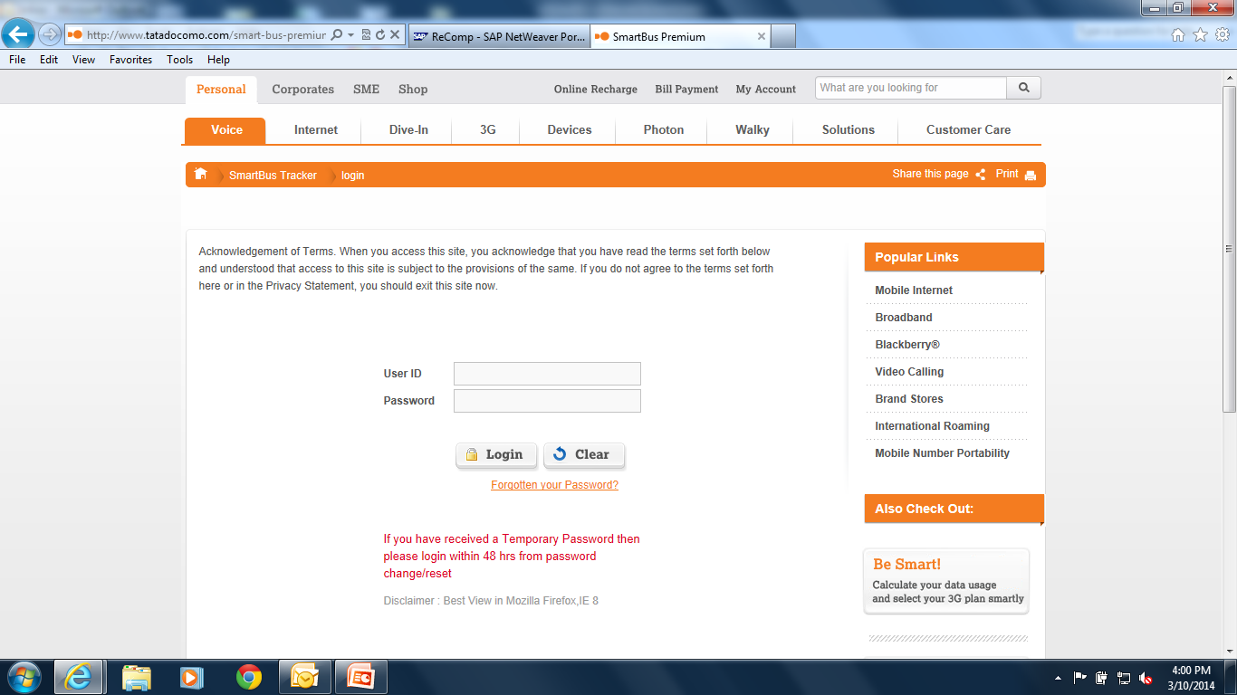
Login Page- http://www.tatadocomo.com/smart-bus-premium.aspx
Login With
User ID- Mobile Number
Password- XXXXX1234

Slide 4
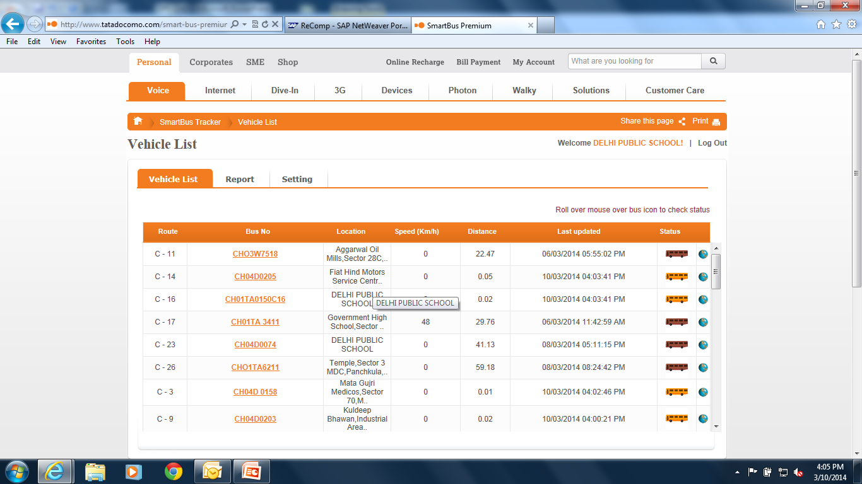
Current Status View- Fleet

Slide 5
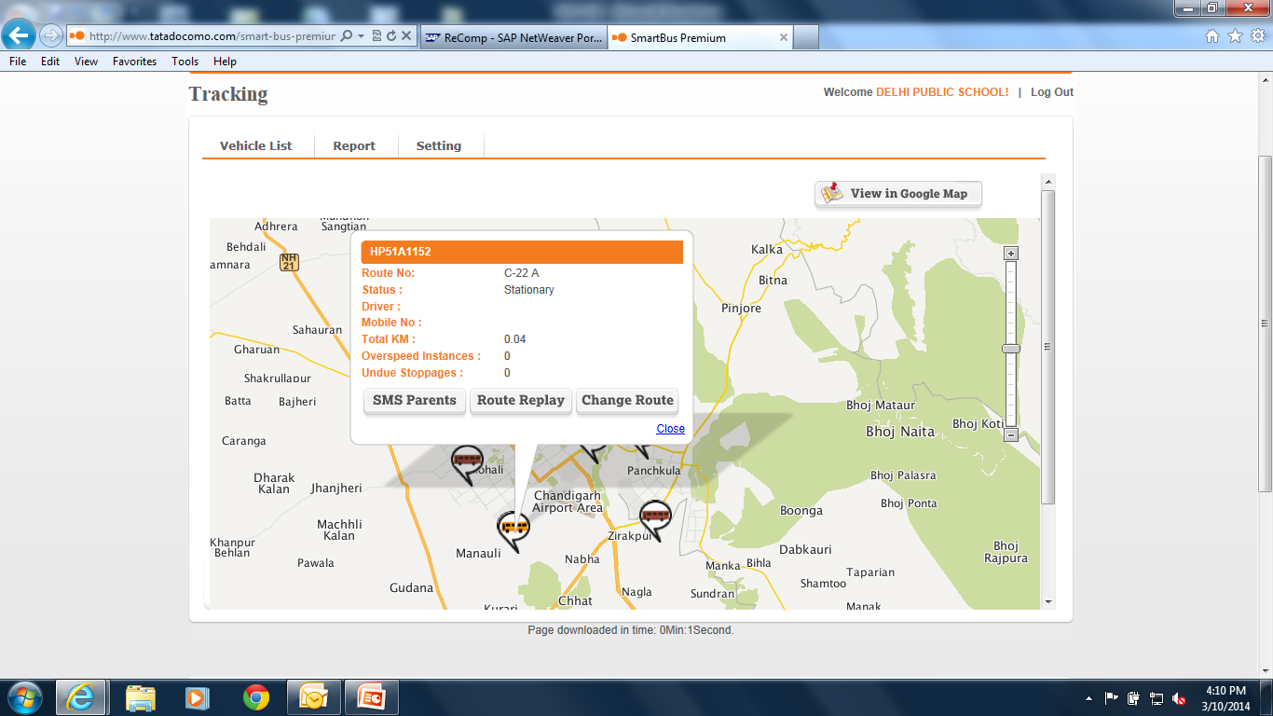
Map View of the Bus
View the current location of the bus on the map with
details like drivers name & number, status of bus,
current location etc.

Slide 6
How to Use
Login to : http://www.tatadocomo.com/smart-bus-premium.aspx on your mobile phone/laptop/Desktop/tablet.
Put user Id- Mobile No & Password- Received through SMS on your mobile
number.
View the current Location of the bus on the MAP, only during route timings.

Slide 7
ETA (Expected Time Of Arrival) delivery SMS to Parents
ETA Delivery- Morning Pick UP Route
1st SMS- Departure
When the bus starts for pick up trip
2nd SMS
ETA SMS- When the bus is about to reach the pick up point.
ETA Delivery- Afternoon Drop Route
1st SMS- Departure
When the bus starts for the drop trip from school
2nd SMS
ETA SMS- When the bus is about to reach the drop point
3rd SMS- Arrival SMS
Once the bus reaches the School.

Slide 8
What does Smart Bus Tracking offers to parents
All the parents will receive an SMS as soon as the bus starts in the morning.
Individual parent will receive an SMS when the bus is near the pick-up point in the morning.
All the parents of the respective buses will receive an SMS when the bus reaches the school in morning .
All parents will receive an SMS when the bus starts from the school in the afternoon to drop their ward.
The parents will receive an SMS when the bus is near their ward’s drop point in the afternoon.

Slide 9
Feedback/Suggestion/Complaint
Kindly call the number given below in case of any Feedback/Suggestion/Complaint.
Mr Sunil Rana- 01726651426
Thank You

